Slide 1


Artificial Intelligence
Unit-4 (Structural Knowledge Representation)
Artificial Intelligence 01CE0702
Department of Computer Engineering

Slide 2
Agents
What is an Agent?
An agent can be anything that perceive its environment through sensors and act upon that environment through actuators. An Agent runs in the cycle of perceiving, thinking, and acting.
An agent can be:
Human-Agent: A human agent has eyes, ears, and other organs which work for sensors and hand, legs, vocal tract work for actuators.
Robotic Agent: A robotic agent can have cameras, infrared range finder, NLP for sensors
and various motors for actuators.
Software Agent: Software agent can have keystrokes, file contents as sensory input and act on those inputs and display output on the screen.

Slide 3
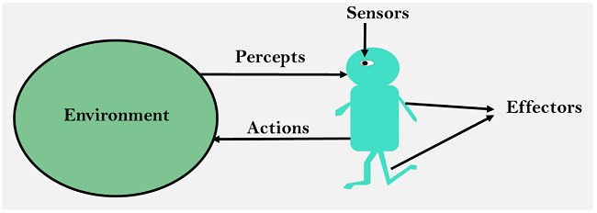
Agents
Sensor: Sensor is a device which detects the change in the environment and sends the information to other electronic devices. An agent observes its environment through sensors.
Actuators: Actuators are the component of machines that converts energy into motion. The actuators are only responsible for moving and controlling a system. An actuator can be an electric motor, gears, rails, etc.
Effectors: Effectors are the devices which affect the environment. Effectors can be legs, wheels, arms, fingers, wings, fins, and display screen.

Slide 4
Agents can be grouped into five classes based on their degree of perceived intelligence and capability :
Types of Agents
Simple Reflex Agents
Model-Based Reflex Agents
Goal-Based Agents
Utility-Based Agents
Learning Agents

Slide 5
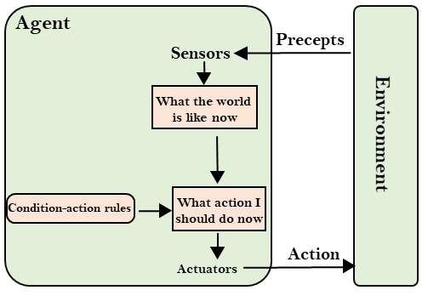
Simple Reflex Agents
The Simple reflex agents are the simplest agents. These agents take decisions on the basis of the current percepts and ignore the rest of the percept history.
These agents only succeed in the fully observable environment.
The Simple reflex agent does not consider any part
of percepts history during their decision and action process.
The Simple reflex agent works on Condition-action
rule, which means it maps the current state to action. Such as a Room Cleaner agent, it works only if there is dirt in the room.
Problems for the simple reflex agent design approach:
They have very limited intelligence
They do not have knowledge of non- perceptual parts of the current state
Mostly too big to generate and to store.
Not adaptive to changes in the environment.
35

Slide 6



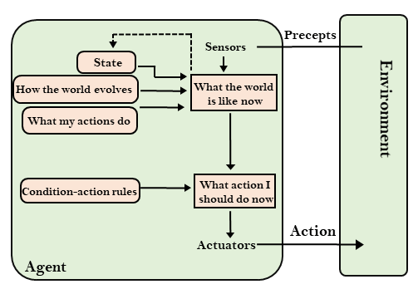
Model-Based Agents
The Model-based agent can work in a partially observable environment, and track the situation.
A model-based agent has two important
factors:
Model: It is knowledge about "how things happen in the world," so it is called a Model-based agent.
Internal State: It is a representation of the current state based on percept history.
These agents have the model, "which is
knowledge of the world" and based on the
model they perform actions.
Updating the agent state requires information about:
How the world evolves
How the agent's action affects the world.

Slide 7
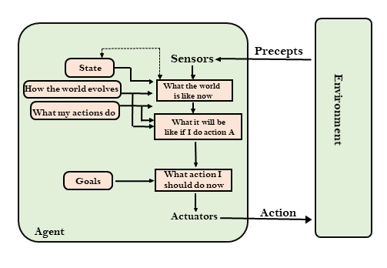
Goal-Based Agents
These kinds of agents take decisions based on how far they are currently from their goal(description of desirable situations).
Their every action is intended to reduce its distance from the goal.
This allows the agent a way to choose among multiple possibilities, selecting the one which reaches a goal state.
The knowledge that supports its decisions is represented explicitly and can be modified, which makes these agents more flexible.
They usually require search and planning. The
goal-based agent’s behavior can easily be changed.

Slide 8
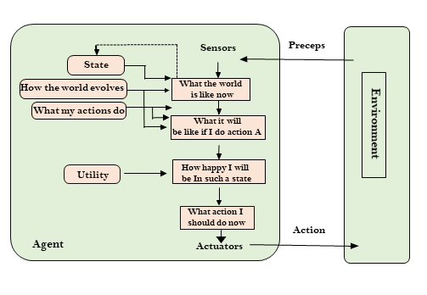
Utility-Based Agents
These agents are similar to the goal-based agent but provide an extra component of utility measurement which makes them different by providing a measure of success at a given state.
Utility-based agent act based not only goals but also the best way to achieve the goal.
The Utility-based agent is useful when there are multiple possible alternatives, and an agent has to choose in order to perform the best action.
The utility function maps each state to a real number to check how efficiently each action achieves the goals.

Slide 9
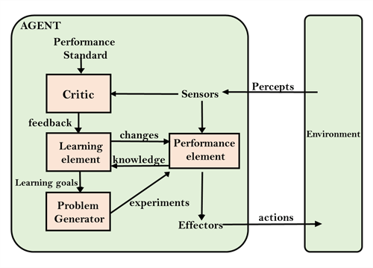
Learning Agents
A learning agent in AI is the type of agent which can learn from its past experiences, or it has learning capabilities.
It starts to act with basic knowledge and then able to act
and adapt automatically through learning.
A learning agent has mainly four conceptual components, which are:
Learning element: It is responsible for making improvements by learning from environment
Critic: Learning element takes feedback from critic
which describes that how well the agent is doing with respect to a fixed performance standard.
Performance element: It is responsible for
selecting external action
Problem generator: This component is responsible for suggesting actions that will lead to new and informative experiences.
Hence, learning agents are able to learn, analyze performance, and look for new ways to improve the performance.
39

